Slide 1

JPEG
Milica Vukićević in Timen Bobnar

Slide 2
Povzetek
Vhodni podatki
Kako nastane slika (RAW format) in predelava v RGB
Pretvarjanje iz RGB v YCrCb
Kosanje slike
Diskretna kosinusna transformacija
Kvantizacija
Linearna transformacija
Kodiranje po dolžini
Hoffmanovo kodiranje
Zapis podatkov

Slide 3
Vhodni podatki za JPEG
RAW – surovi format
JPEG format
PNG
TIFF
Bitmap

Slide 4
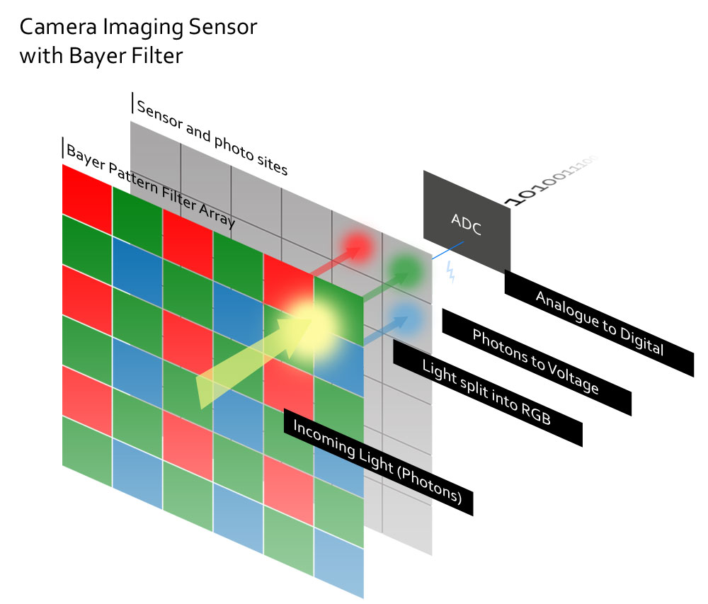
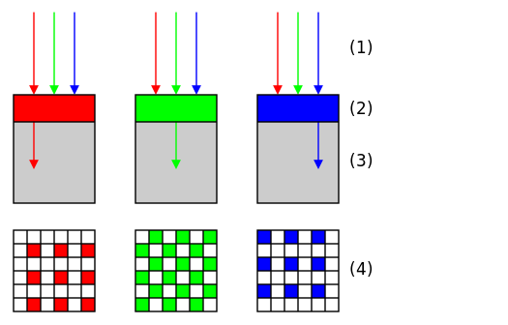
Kako nastane slika
https://en.wikipedia.org/wiki/Bayer_filter
https://silentpeakphoto.com/gear/cameras/camera-guides/how-do-camera-imaging-sensors-work/

Slide 5

Demosaiciranje
Po koncu demosaiciranja dobimo sliko v RGB formatu
http://mres.uni-potsdam.de/index.php/2018/07/10/multispectral-cameras-bayer-mosaics-and-image-processing-with-matlab/

Slide 6
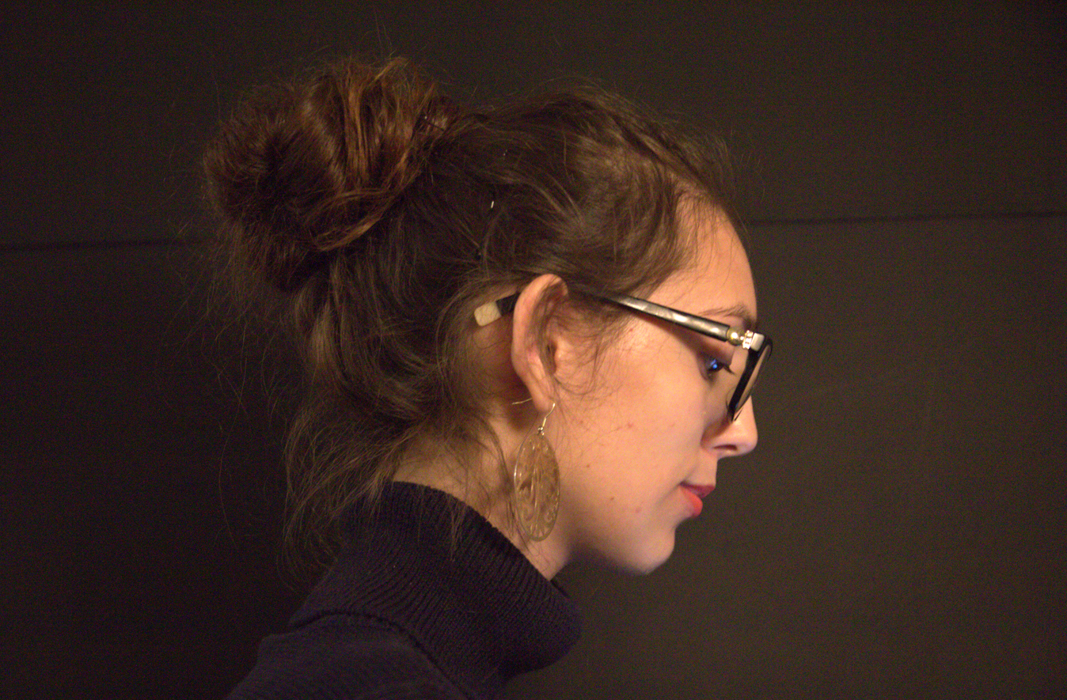

Slide 7


Slide 8
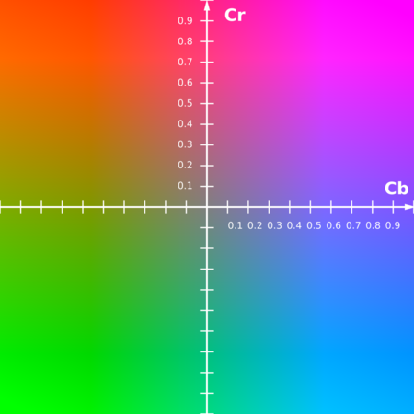
Transformacija iz RGB v YCrCb
Y – svetilnost
Cr, Cb – barvnost
Y= 16 + 65.738*R/256 + 129.057*G/256 + 25.064*B/256
Cb = 128-37.945*R/256 - 74.494*G/256 + 112.439*B/256
Cr = 128+112.439*R - 94.154*G/256 - 18.285*B/256

Slide 9
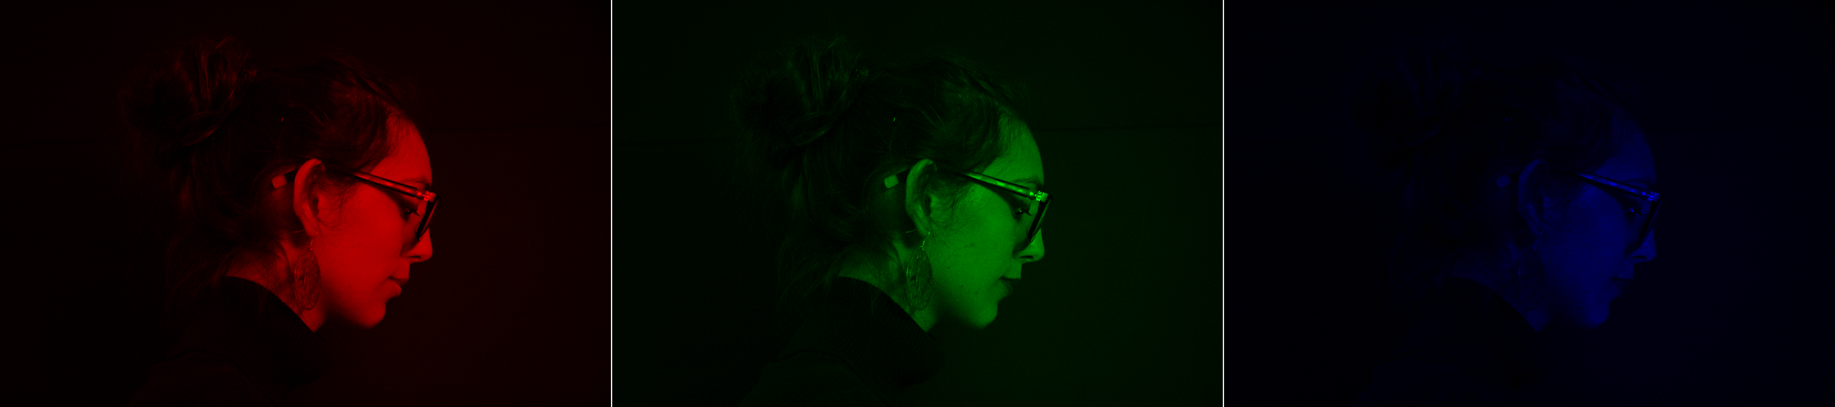


Slide 10
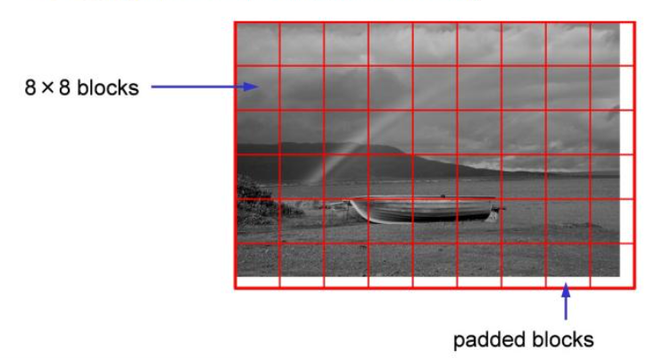
Kosanje slike
https://dsp.stackexchange.com/questions/35339/jpeg-dct-padding

Slide 11
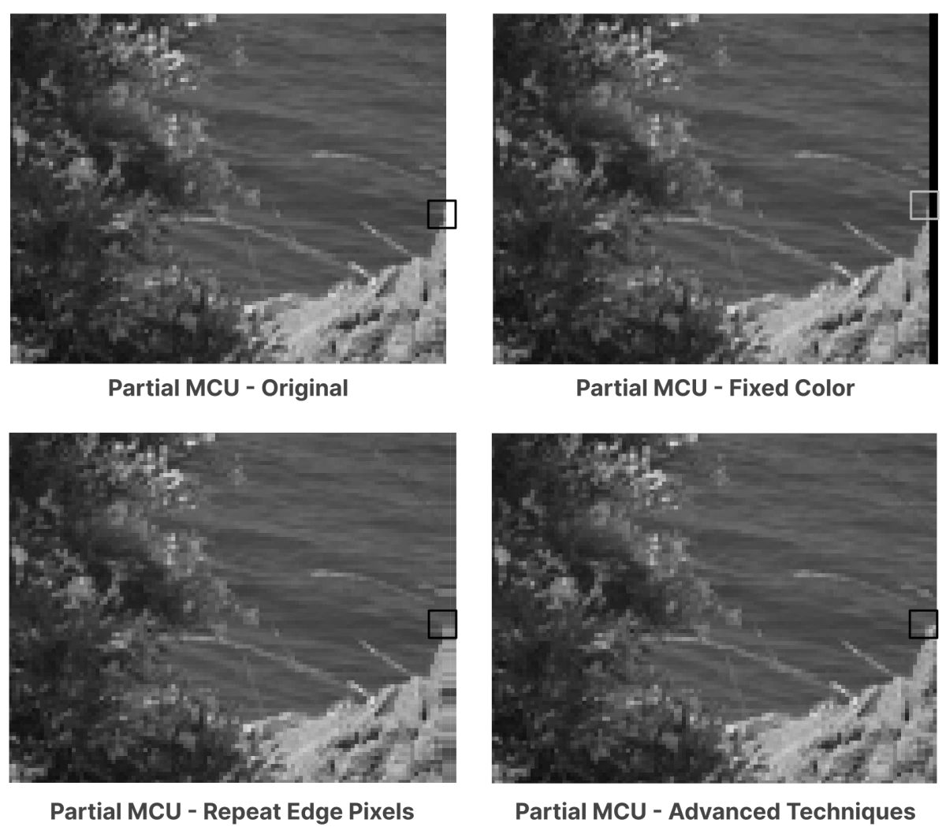
Rešitve problema kosanja slik
Dodamo rob neutralne barve
Zadnje vrstice in stolpce podvojimo
Obrežemo sliko
https://www.thewebmaster.com/jpeg-definitive-guide/

Slide 12
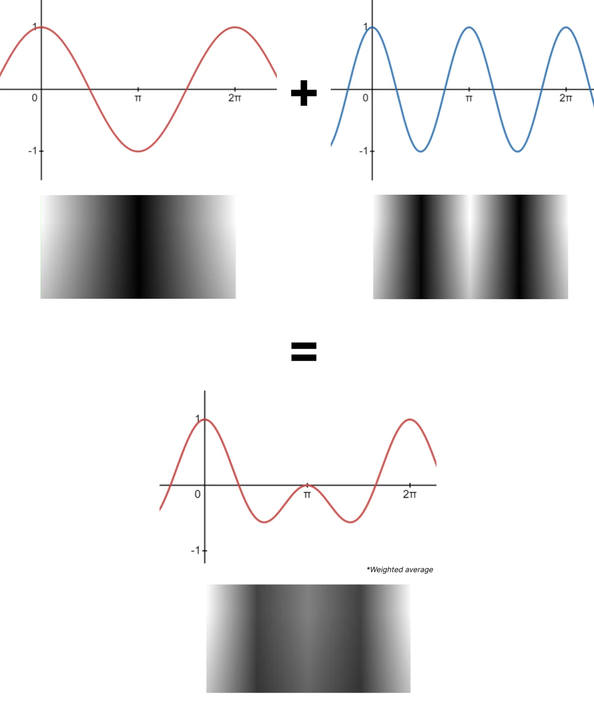
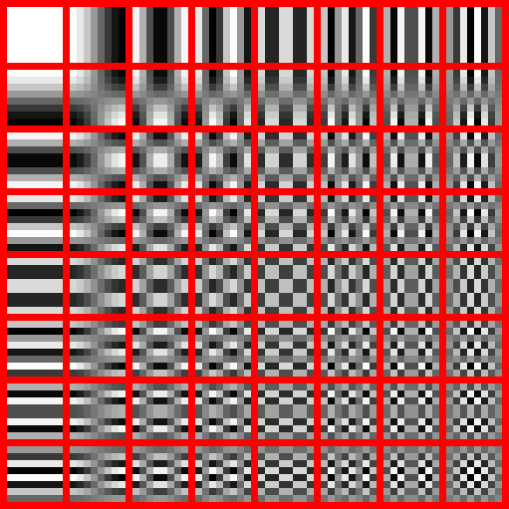
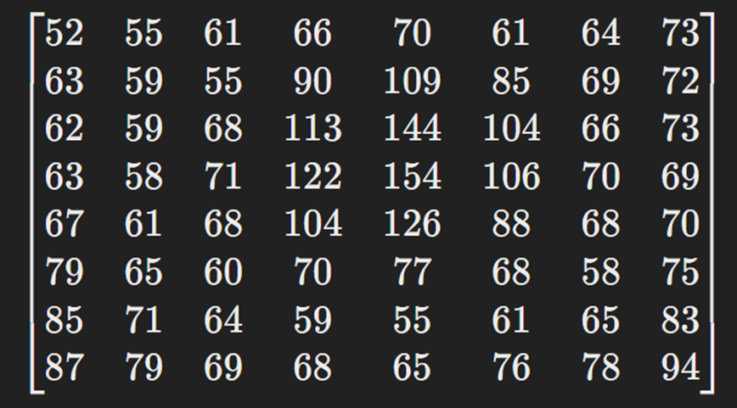
Diskretna Kosinusna Transformacija - DCT
https://en.wikipedia.org/wiki/JPEG#/media/File:Dctjpeg.png
https://www.thewebmaster.com/jpeg-definitive-guide/

Slide 13
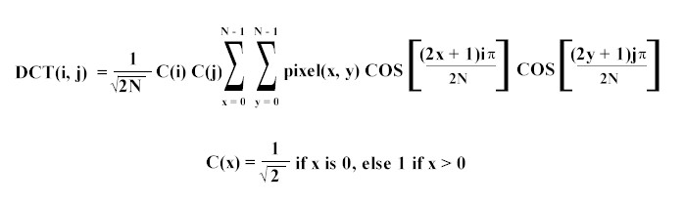
Diskretna Kosinusna Transformacija - DCT
https://cs.stanford.edu/people/eroberts/courses/soco/projects/data-compression/lossy/jpeg/dct.htm

Slide 14
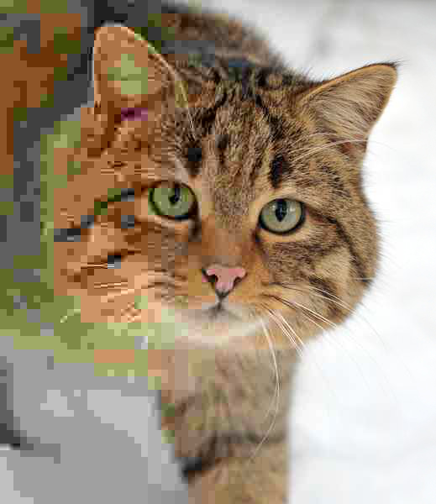

Diskretna Kosinusna Transformacija
https://en.wikipedia.org/wiki/File:Felis_silvestris_silvestris_small_gradual_decrease_of_quality.png

Slide 15
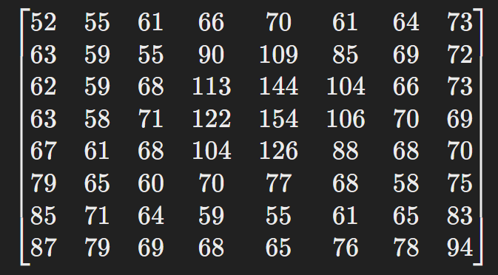
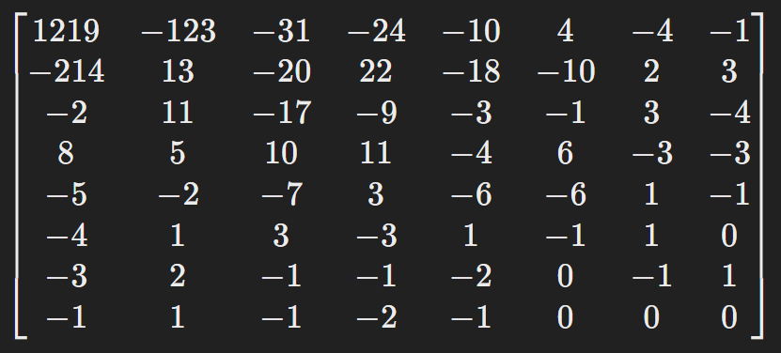
Primer

Slide 16
Kvantizacija
Svetilnost
Barvnost
16 11 10 16 24 40 51 61
12 12 14 19 26 58 60 55
14 13 16 24 40 57 69 56
14 17 22 29 51 87 80 62
18 22 37 56 68 109 103 77
24 35 55 64 81 104 113 92
49 64 78 87 103 121 120 101
72 92 95 98 112 100 103 99
17 18 24 47 99 99 99 99
18 21 26 66 99 99 99 99
24 26 56 99 99 99 99 99
47 66 99 99 99 99 99 99
99 99 99 99 99 99 99 99
99 99 99 99 99 99 99 99
99 99 99 99 99 99 99 99
99 99 99 99 99 99 99 99

Slide 17
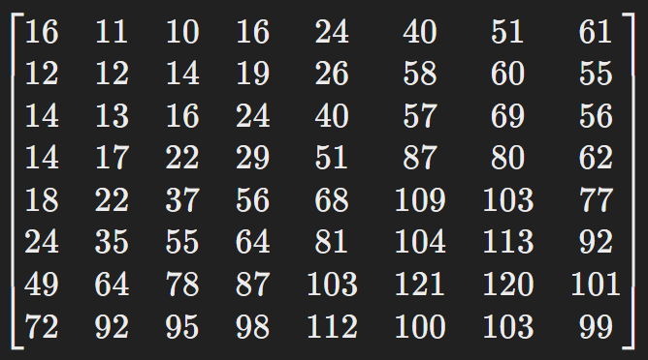
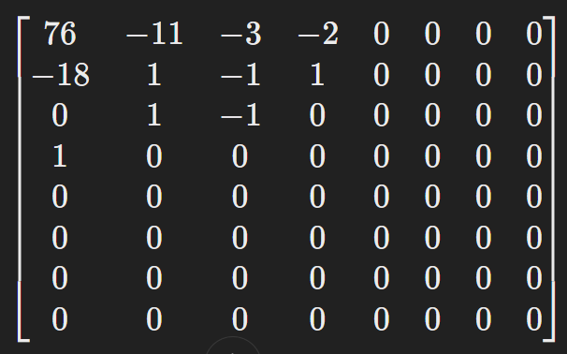

Slide 18
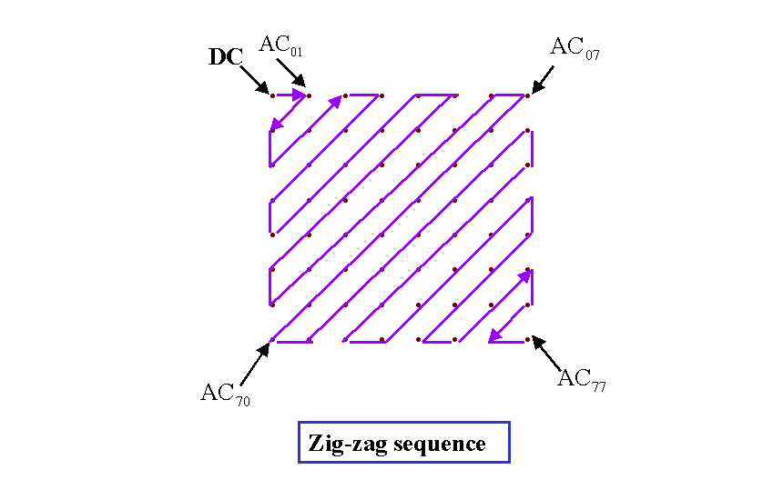
Linearna transformacija
{76, - 11, - 18, 0,1, -3, -2, -1, 1, 1, 0, 0, -1, 1, 0,...., 0}
https://www.cmlab.csie.ntu.edu.tw/cml/dsp/training/coding/jpeg/jpeg/encoder.htm

Slide 19

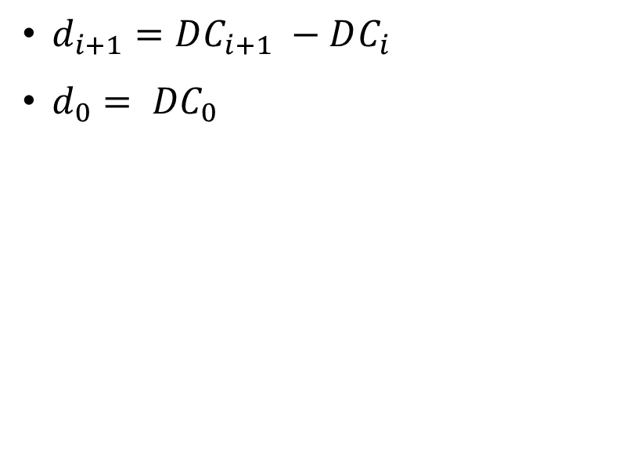
Linearna transformacija
$d_{i+1}=DC_{i+1} −DC_{i}$
$d_{0}= {DC}_{0}$
https://www.cmlab.csie.ntu.edu.tw/cml/dsp/training/coding/jpeg/jpeg/encoder.htm
https://www.rocknews.co.uk/blog/2023/03/02/thunderous-titans-of-rock-why-ac-dc-reigns-supreme/

Slide 20
Kodiranje po dolžini (RLE)
{76, - 11, - 18, 0,1, -3, -2, -1, 1, 1, 0, 0, -1, 1, 0,...., 0}
(1, -11), (1, - 18), (1, 0), (1, -3), (1, -2), (1, -1), (2, 1), (2, 0), (1, -1), (1, 1), (50, 0)
{100, 5, -3, 5, 0, 0, 1, 8, -3, 2, -1, -1, -1, 0, 0, 0, 1, 0,..., 0}
(1, 5), (1, -3), (1, 5), (0, 2), (1, 1), (1, 8), (1,-3), (1, 2), (3, -1), (3, 0), (1, 1), (47,0)

Slide 21
Huffmanovo kodiranje
ABCDAACDCBBAA
8x13 = 104
5x1 + 3x2 + 3x3 + 2x3 = 26
Črka | Št. ponavljanj | ASCII binarni zapis | Zapis po Hoffmanovom kodiranju
A | 5 | 01000001 | 1
B | 3 | 01000010 | 01
C | 3 | 01000011 | 000
D | 2 | 01000100 | 001

Slide 22
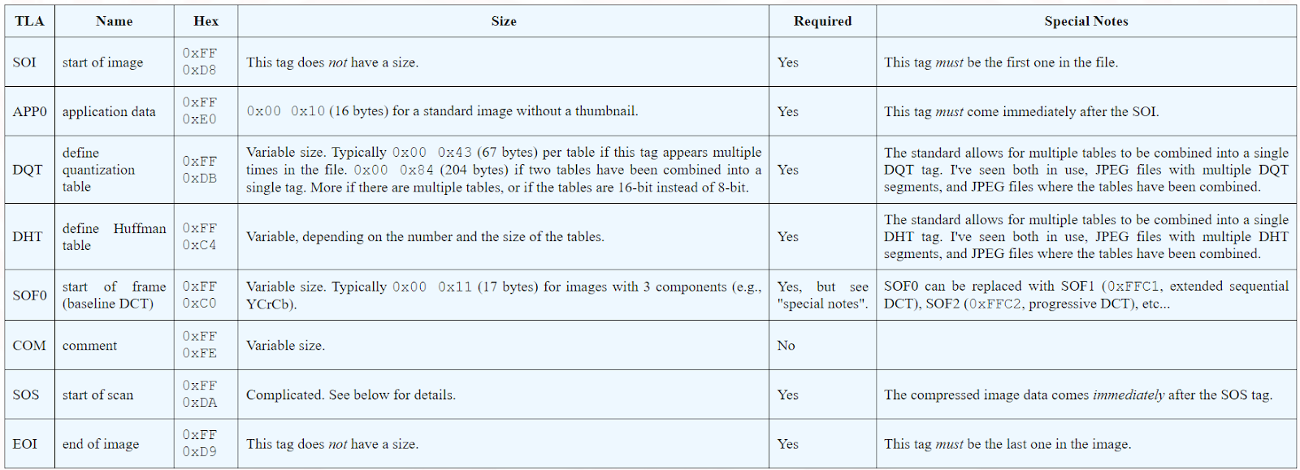
Zapis in shranjevanje podatkov
https://www.ccoderun.ca/programming/2017-01-31_jpeg/

Slide 23
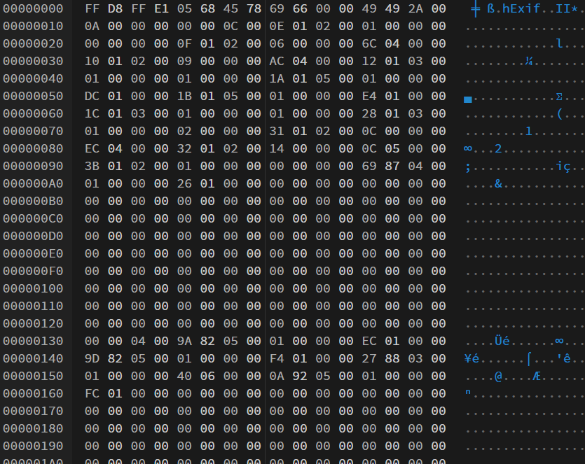
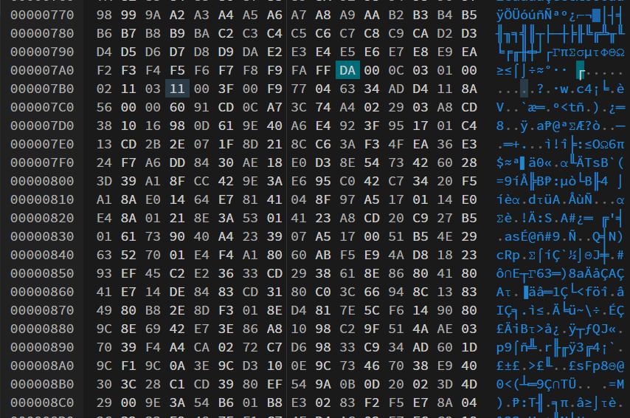
Zapis in shranjevanje podatkov

Slide 24
